Slide 1
Deepfake Videos in the Wild: Analysis and Detection
Presenters - Swati Adhikari & Harrison Williams
Archaeologists - Afrina Tabassum & Gaurang Karwande
Industry Expert - Provakar Mondal
Ethicist - Amarachi Mbabwe

Slide 2
What are Deepfakes?
a way of manipulating video content where the face of a person is swapped in by another face, using Deep Neural Network-based methods
raises serious ethical issues because they can be misused

Slide 3
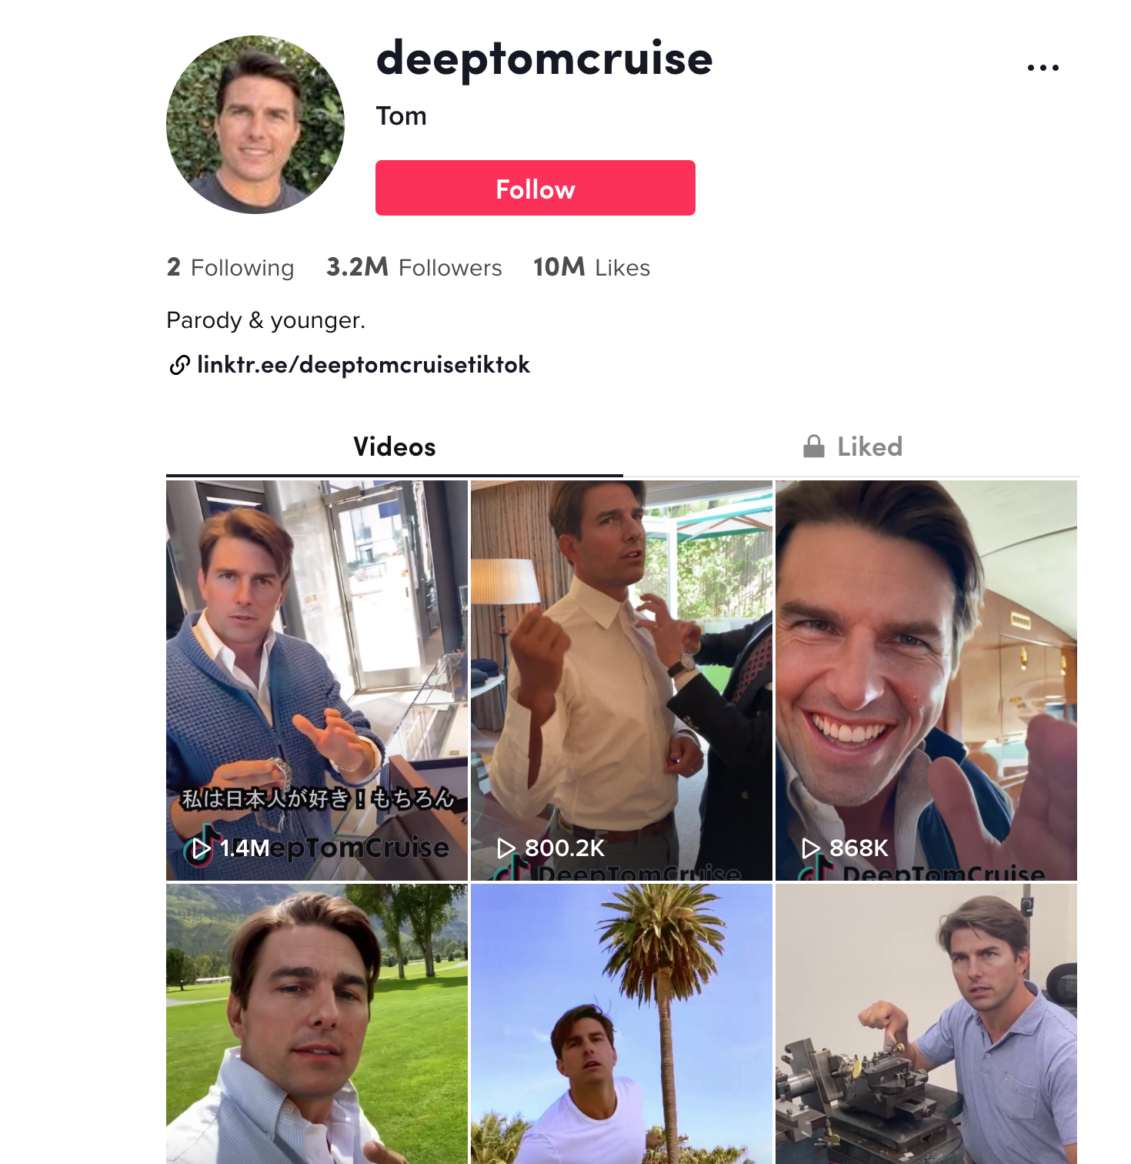
This isn’t Tom Cruise!
These deepfakes were created by visual and AI effects artist Chris Umé with the help of a Cruise stand-in, actor Miles Fisher.

Slide 4
Problem definition
Researchers in academia and industry have contributed several benchmark deepfake datasets and deepfake detection algorithms. However, limited efforts have been made to study deepfake videos in the wild, leading to a limited understanding of the real-world applicability of research contributions in this space.

Slide 5
Motivation
How are deepfake videos created in the wild?
Are deepfakes in the wild different from deepfake videos produced by the research community?
Are deepfakes increasingly appearing in the wild? Are they being viewed by large populations?
Can existing deepfake detection schemes accurately detect deepfake videos in the wild?

Slide 6
The paper covers:
Introduction of a new deepfake dataset called DF-W, comprised of deepfake videos created and shared by the Internet community.
A comprehensive analysis of the videos in the DF-W.
Evaluation of the performance of state-of-the-art deepfake detection schemes on videos in DF-W.
Exploration of approaches to improve detection performance.

Slide 7
Methods for Generating Deepfakes:
1. FaceSwap: An open-source tool which uses two deep autoencoders that share the encoder module, but use different decoders. The two autoencoders are trained separately on the source and target faces to reconstruct each face from a latent representation.
2. DeepFaceLab (DFL): An open-source tool with the combined use of DSSIM and Mean Square Error reconstruction losses for autoencoder training.

Slide 8
DF-W dataset
DF-W comprises of deepfake videos created and shared by the Internet community.
The dataset is prepared by scanning a variety of sources on the Web, including 1,869 videos from YouTube and Bilibili, comprising of over 48 hours of video, covering a wide range of video resolutions.

Slide 9
DF-R dataset
This dataset represents all the research community datasets, by sampling deepfake videos from the 6 datasets: UADFV, DeepFakeTIMIT, FaceForensics++, DFD, Celeb-DF, and DFDC. It contains a total of 2,369 deepfake videos, and 2,316 real videos.

Slide 10
DF-W (Internet community dataset) | DF-R (Research community dataset)
DFL is a popular deepfake generation method. | DFL is not used by any of the existing research community datasets.
Only a fraction of the frames contain fake content. | Every frame contains some fake content.
Nearly 26% of the dataset contain more than a single face. | 92% to 100% of videos contain only a single face.
DF-W videos are longer in duration. | DF-R Videos are shorter in duration.

Slide 11
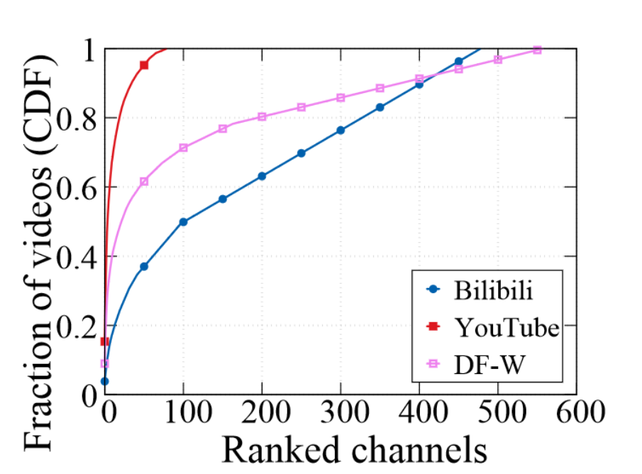
Deepfake videos reach a large audience
33 deepfake videos across Youtube and Bilibili with over 500,000 views
69% and 27% of the DF-W videos found on Youtube and Bilibili, respectively, have over 1,000 views
Youtube is dominated by a few deepfake content creators, while Bilibili has many relatively popular creators
Generation methods/defenses for large and small creators may differ because of different resources available to each
Pu, et al. 2021. Deepfake Videos in the Wild: Analysis and Detection. In Proceedings of the Web Conference 2021 (WWW '21).

Slide 12
Experimental setup
Modifications to existing classifiers
Most existing classifiers treat detection as a binary frame-by-frame decision which yields high performance
Video-level classification just uses the average of each frame
Problem: DF-W videos have a lot of unmodified frames which skew this metric
Better approach: calculate video-level decision by averaging the top ~33% of frame-level probabilities

Slide 13
Detection methodologies
Supervised models:
CapsuleForensics: reported 92% accuracy
Xception: 99% accuracy
MesoNet: 97% accuracy
Multi-Task: 92% accuracy
Unsupervised models
FWA: 99.9% accuracy
DSP-FWA: Not reported
All models report >90% accuracy

Slide 14
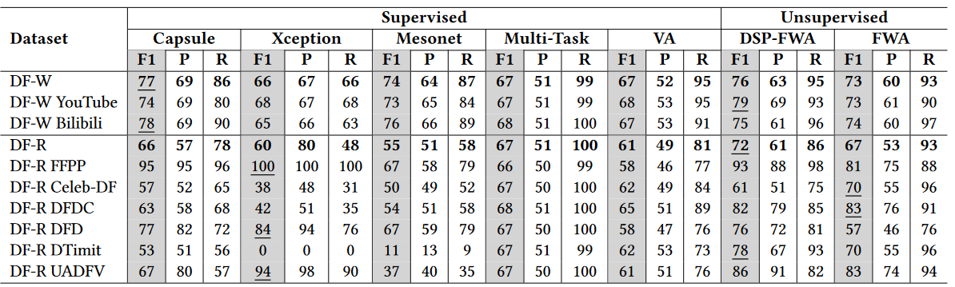
Experimental results
Pu, et al. 2021. Deepfake Videos in the Wild: Analysis and Detection. In Proceedings of the Web Conference 2021 (WWW '21).

Slide 15
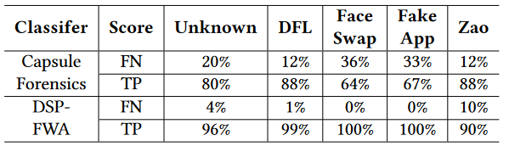
Discussion
Classifiers fail to generalize to real-world deepfake videos
Highest performance on DF-W dataset is F1-score of 77%
Similarly poor performance generalizing even to simpler DF-R dataset: best performance is F1-score of 72%
Pu, et al. 2021. Deepfake Videos in the Wild: Analysis and Detection. In Proceedings of the Web Conference 2021 (WWW '21).
Best performers work reasonably well on DFL, the most common generation method

Slide 16
Exploring sources of failure
Racial bias
Deepfake detection schemes depend on facial detection software which is known to suffer from racial bias
Best overall performer (CapsuleForensics): 48% F1 score for Asian faces vs 72% and 74% for Caucasian and Black faces
External features
Introducing relevant background features around a face makes CapsuleForensics 4.8x more likely to mis-classify a video as real
Recognizing facial boundaries to cut out background features is critical for deepfake detection

Slide 17
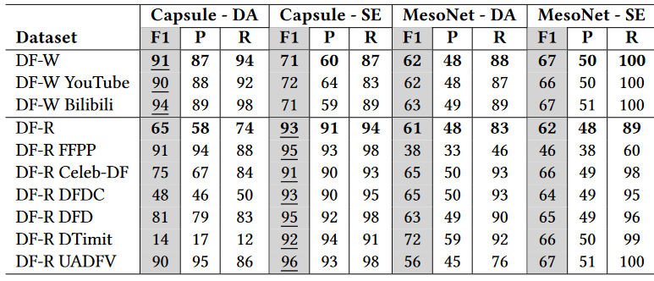
Improving detection performance
Pu, et al. 2021. Deepfake Videos in the Wild: Analysis and Detection. In Proceedings of the Web Conference 2021 (WWW '21).
Domain Adaptation (DA): retraining with a subset of DF-W
Source Expansion (SE): retraining with a subset of DF-R

Slide 18
Retraining performance
Retraining improves model performance with some caveats:
Potentially overfitting to the retraining dataset:
Domain adaptation improves CapsuleForensics’s performance on DF-W and degrades it on DF-R
Similarly, source expansion improves performance on DF-R and degrades it on DF-W
Not all models are amenable to retraining through transfer learning:
Domain adaptation degrades MesoNet’s performance on DF-W
Authors propose this may be due to information capacity of each net: CapsuleNet is 140x larger than MesoNet

Slide 19
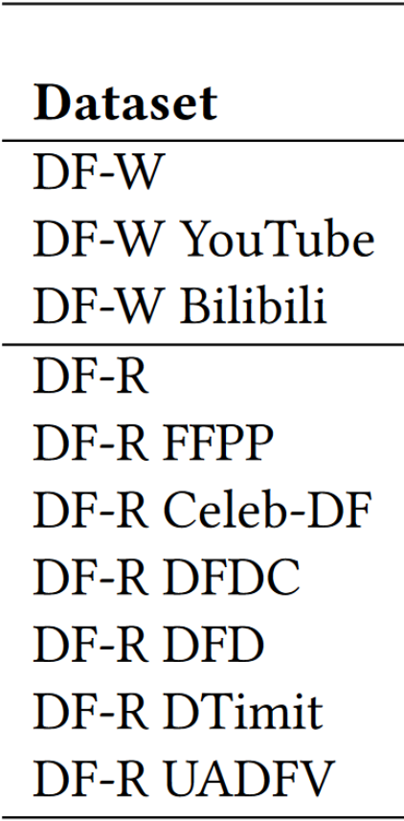
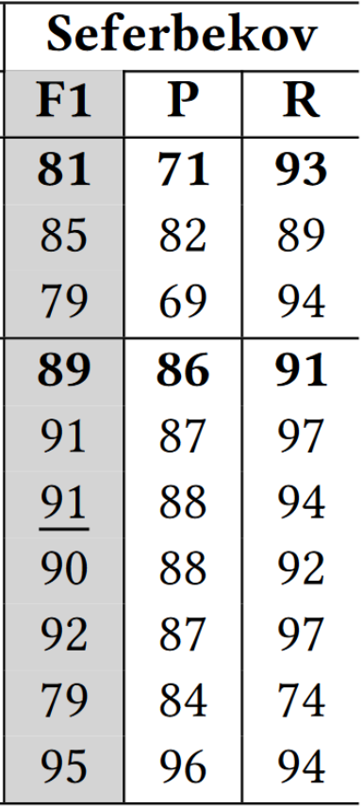
Public deepfake detection models
Instead of research models, outsource detection to the public through competitions
Combination of 7 different models
Pretrained on largest dataset evaluated (13x more videos than CapsuleForensics)
Outperforms research models without DA/SE
Conclusion: Deepfake videos are a pervasive problem which existing research datasets and ML models fail to represent and detect

Slide 20
DeepFaceLab: Integrated, flexible and extensible face-swapping framework
Ivan Petrov, et.al.
Archeologist

Slide 21
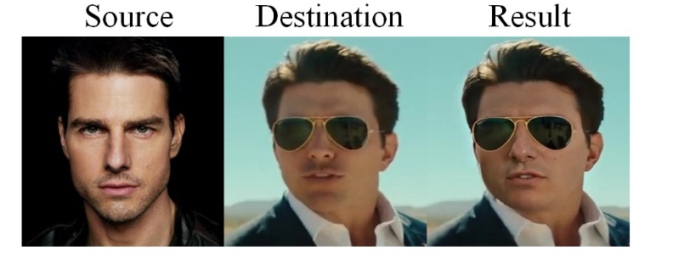
Motivation
Assisting research in identifying manipulated videos

Slide 22
DeepFaceLab Pipeline
Extraction
Training
Conversion

Slide 23
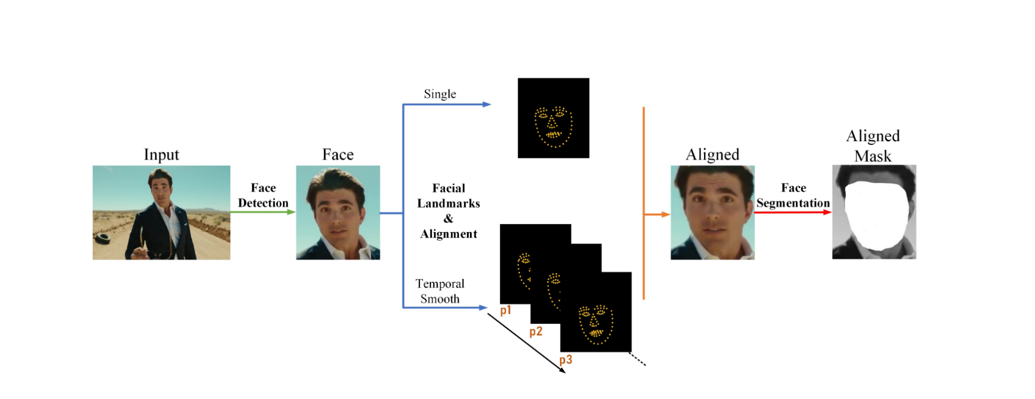
Extraction
Face Detection: detect faces in source and destination (S3FD face detector[1])
[1]Shifeng Zhang, Xiangyu Zhu, Zhen Lei, Hailin Shi, Xiaobo Wang, and Stan Z Li. S3fd: Single shot scale-invariant face detector. In Proceedings of the IEEE International Conference on Computer Vision, pages 192–201, 2017. 3

Slide 24
Extraction
Face Alignment: using two facial landmark algorithms -
heatmap-based facial landmark algorithm 2DFAN[1]
PRNet [3] with 3D face prior information (for faces with large Euler angle (yaw, pitch, roll),
[1]Adrian Bulat and Georgios Tzimiropoulos. How far are we from solving the 2d & 3d face alignment problem?(and a dataset of 230,000 3d facial landmarks). In Proceeding of the IEEE International Conference on Computer Vision, pages 1021–1030, 201
[2]Yao Feng, Fan Wu, Xiaohu Shao, Yanfeng Wang, and Xi Zhou. Joint 3d face reconstruction and dense alignment with position map regression network. In Proceedings of the European Conference on Computer Vision (ECCV), pages 534–551, 2018.
Notes:
2DFan - for faces with standard pose
PRNet - e.g., A face with a large yaw angle, means one side of the face is out of sight).

Slide 25
Extraction
Face Segmentation: Emply Face segmentation Network (TernausNet [1])
[1]Vladimir Iglovikov and Alexey Shvets. Ternausnet: U-net with vgg11 encoder pre-trained on imagenet for image segmentation. arXiv preprint arXiv:1801.05746, 2018

Slide 26
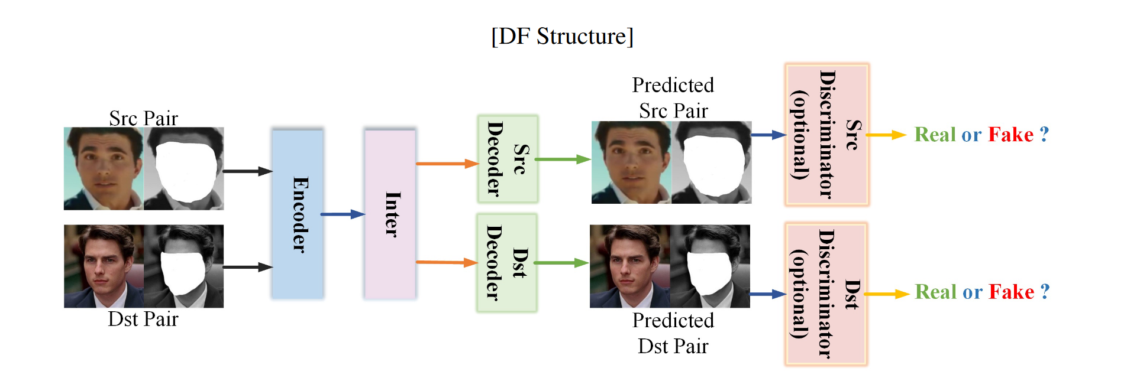
Training
DF : DF structure finish the face-swapping task
Limitation - cannot inherit enough information from dst, such as lighting
Notes:
once we have cropped faces with their corresponding coordinates in its original images, facial landmarks, aligned faces, and pixel-
wise segmentation masks from src and destination
We enter the Training phase in the pipeline

Slide 27
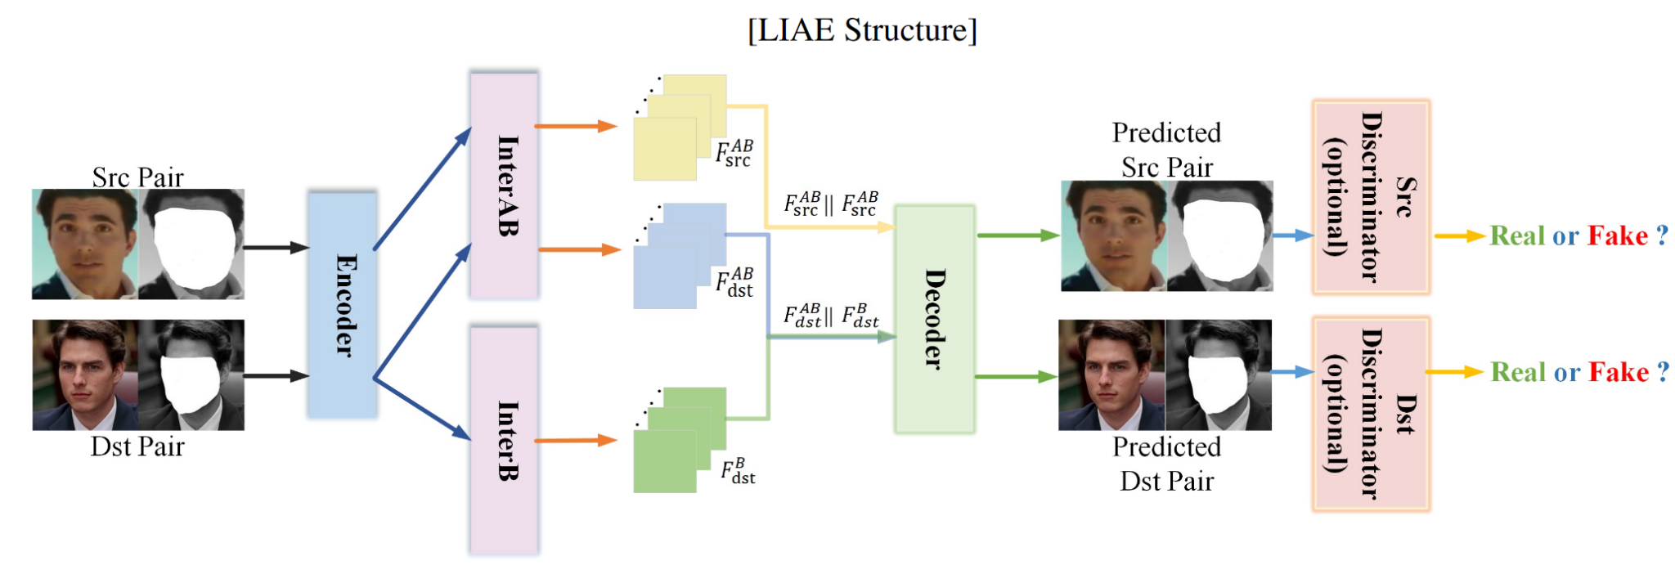
Training

Slide 28
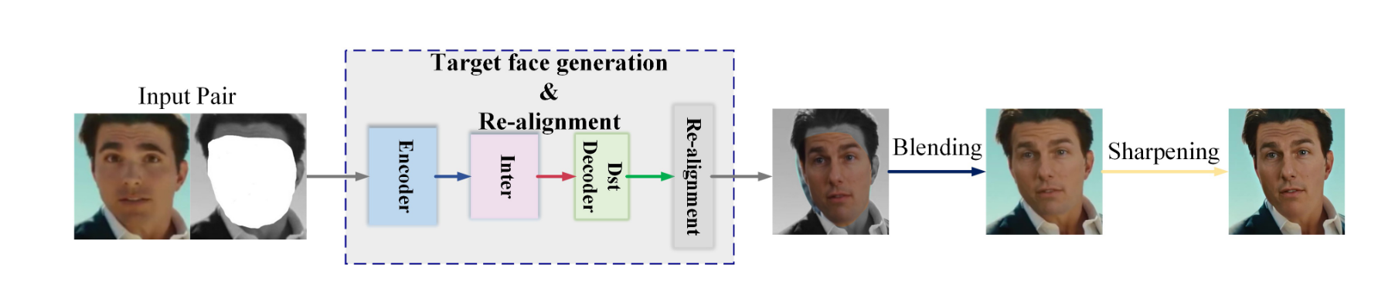
Conversion
transform generated face (& its mask) from dst Decoder to the original position of the target image in src

Slide 29
Evaluation of an Audio-Video Multimodal Deepfake Dataset using Unimodal and Multimodal Detectors
Khalid, H., et. al.
Archeologist

Slide 30
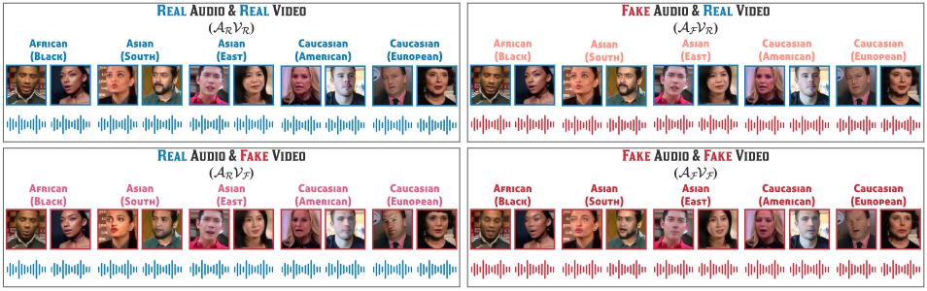
Deepfakes come in different modalities
Khalid, H., Tariq, S., Kim, M., & Woo, S. S. (2021). FakeAVCeleb: A Novel Audio-Video Multimodal Deepfake Dataset. arXiv preprint arXiv:2108.05080.

Slide 31
Deepfake - Video
Superimpose source image onto target image
Techniques - AEs, VAEs, GANs

Slide 32
Deepfake - Audio
Voice spoofing attacks - impersonation, replay, synthetic audio
Google Tacotron: Text to speech generation
Wav2lip: Lip synchronization network
Google ASVspoof challenge
Wang, Yuxuan, et al. "Tacotron: Towards end-to-end speech synthesis." arXiv preprint arXiv:1703.10135 (2017).

Slide 33
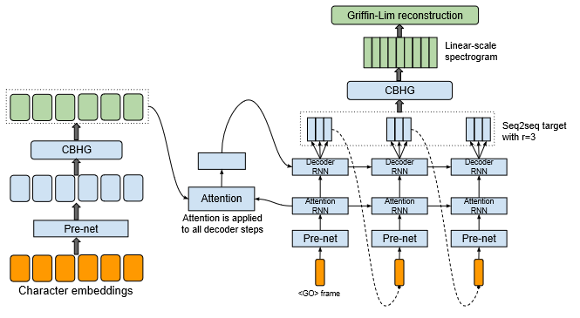
Google Tacotron
Wang, Yuxuan, et al. "Tacotron: Towards end-to-end speech synthesis." arXiv preprint arXiv:1703.10135 (2017).
Notes:
The model takes characters as input and outputs the corresponding
raw spectrogram, which is then fed to the Griffin-Lim reconstruction algorithm to synthesize speech. Seq2Seq model

Slide 34
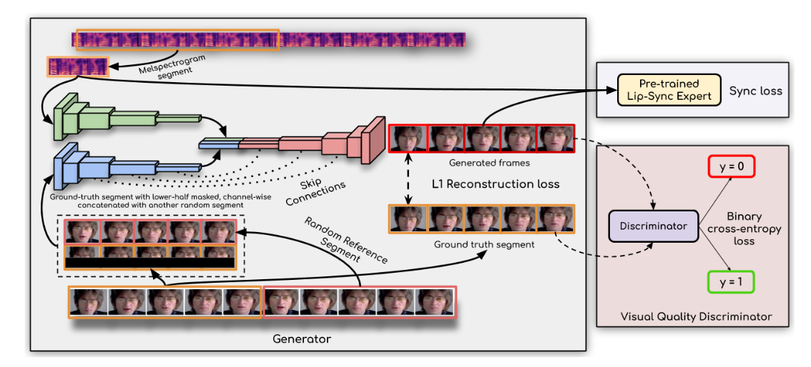
Wav2lip
Prajwal, K. R., et al. "A lip sync expert is all you need for speech to lip generation in the wild." Proceedings of the 28th ACM International Conference on Multimedia. 2020.
Notes:
LipGAN, SyncNet modifications - new loss, deeper with skip connections

Slide 35
Deepfake detection methods are too specific
Need a system that is robust enough to identify fake video OR fake audio OR fake audio + video
Limitations - Dataset !
Notes:
Trained on image features or audio features not both

Slide 36
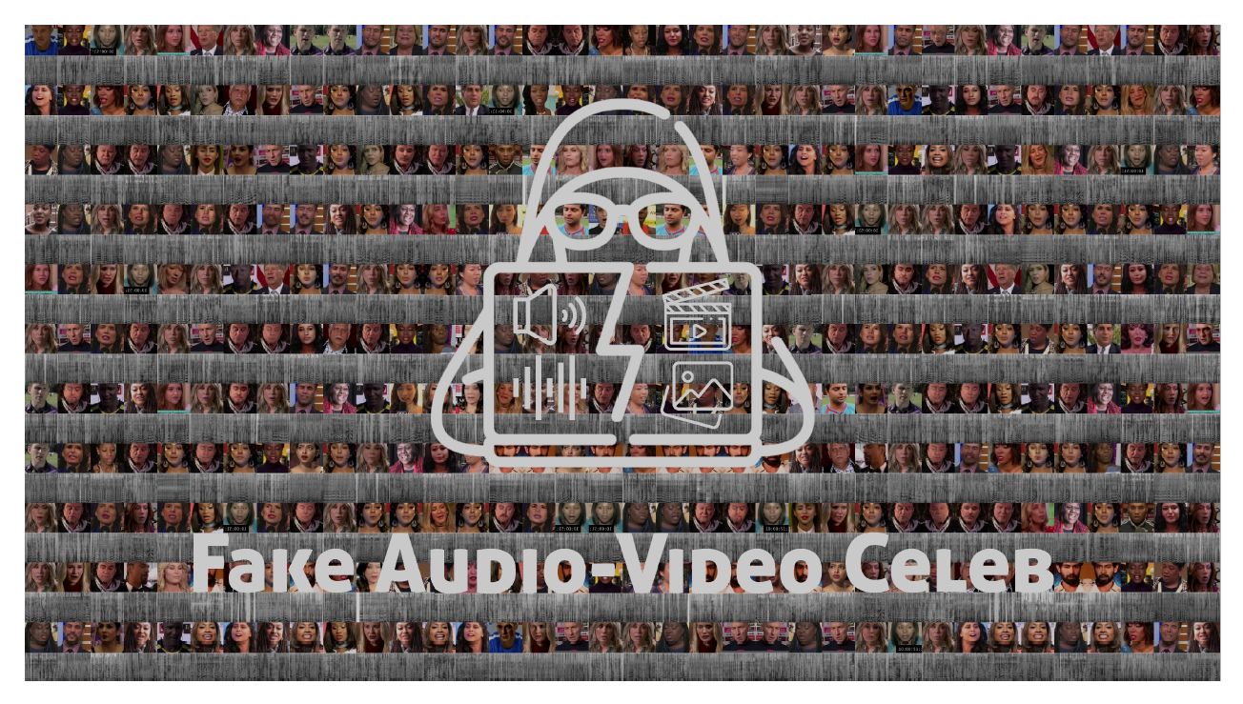
FakeAVCeleb Dataset
Curated to avoid racial and gender bias
Video - facial reenactment, face-swapping with FSGAN, DeepFaceLab
Audio - cloned speech synthesis with RTVC
Refinement - face reenactment based upon source audio with Wav2Lip
Khalid, Hasam, et al. "FakeAVCeleb: A Novel Audio-Video Multimodal Deepfake Dataset." arXiv preprint arXiv:2108.05080 (2021).

Slide 37
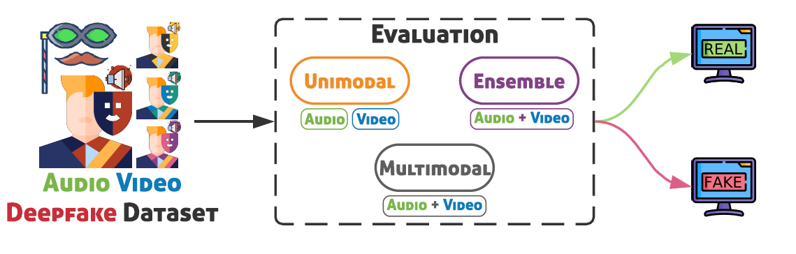
Methods

Slide 38
Results
Unimodal
Video [VGG16] : 73%
Audio [Xception] : 76%
Ensemble
VGG classifiers : 78%
Multi-modal
Multi-modal 2 : 67.3%
Notes:
Video - trained on image features. Audio - trained on audio features
About multi-modal model. Actually for recipe generation. No multi-modal model for deepfake detection. More detailed analysis - precision, recall in real and faked videos, as well as wrt video and audio fakes in the paper. Hence there is a need for more research in this domain.
Multi-modal 1 - recipe
Multi-modal 2 - movie genre identify
CDN - face anti-spoffing

Slide 39
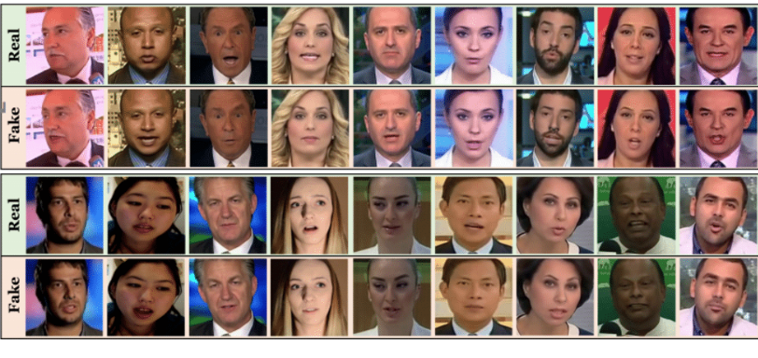
Industry Applications
Applicable industries:
Social platform, Digital identity authentication
Notes:
References: Digital ID verification increasingly targeted by AI deepfakes, advisory warns
Top 30 Industry Leaders in Digital Identity

Slide 40
Worth Investment in industry?
YES!
But why?
Collected deepfake data from various sources.
Revealed poor detection performance.
Suggested distributional difference between existing research community dataset and in-the-wild dataset.
Attributed detection failures and integrated model interpretations schemes to improve detection.

Slide 41
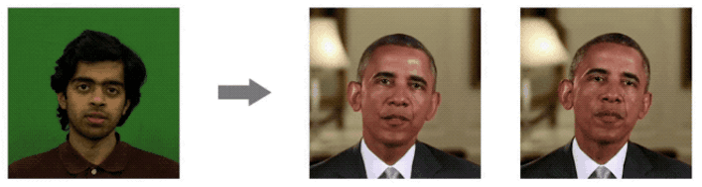
Ok, worth of Industry Applications but any limitation?
The proposed method in this paper is worthy to apply in real-time industrial applications. But it has a limitation in that it can’t detect all kinds of deepfake generation methods. E.g. Two-stream, HeadPose, FaceXray, etc.
Notes:
Reference: Deepfake Videos Are Getting Impossibly Good
Example of Headpose that the proposed method in the paper can’t detect.

Slide 42
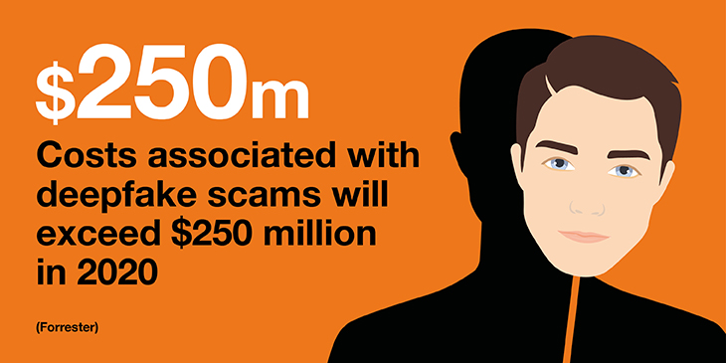
Ethical Impact
Economic impacts of Deepfakes:
Digital impersonation of executives to extort funds or aid fraud.
Falsify evidence like false insurance claims.
Threat to cybersecurity.

Slide 43
Social impact of Deepfakes
Privacy: stealing one’s identity without consent.
Incite violence.
Crime impersonation.
Weakens virtue.
Undermine trust.

Slide 44
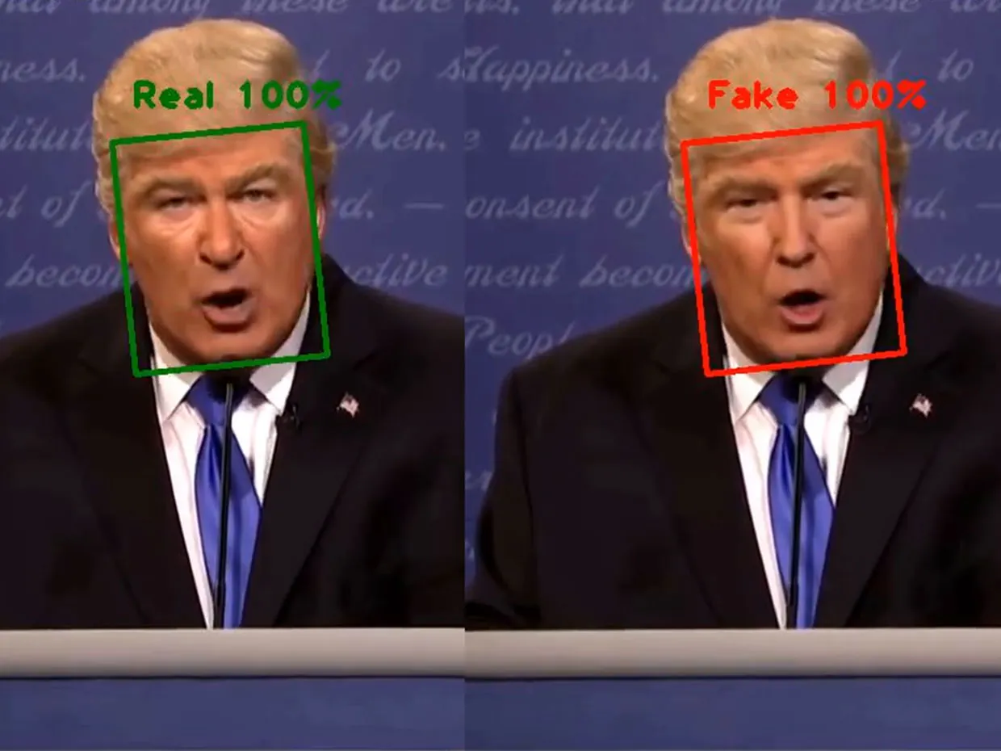
Positive impact of Deepfake detection system
Reduction of crimes.
Prevents misinformation.
Regains trust of the people in online information.

Slide 45
Negative impact of Deepfake detection systems
Advanced deepfakes -> Poor performance -> Wrong classification -> Bigger problem
Prone to manipulation by wrong users.

Slide 46
Questions?

